Slide 1

Name of Lodge No. ---
ENTERED APPRENTICE DEGREE

Slide 2

ENTERED APPRENTICE DEGREE
FIRST SECTION

Slide 3
ENTERED APPRENTICE DEGREE
SECOND SECTION

Slide 4
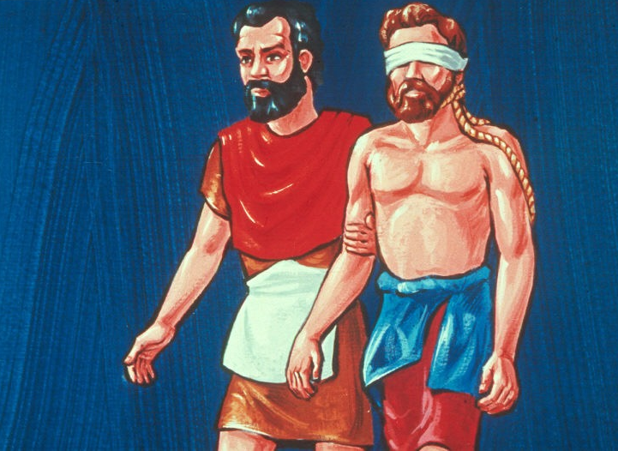

Slide 5
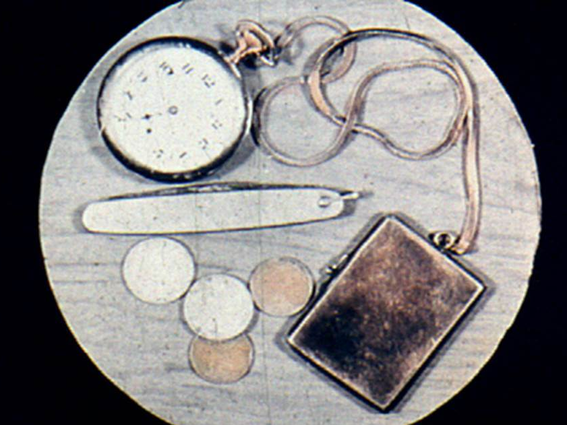

Slide 6


Slide 7
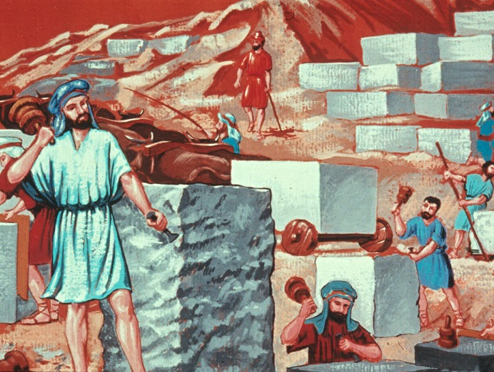

Slide 8
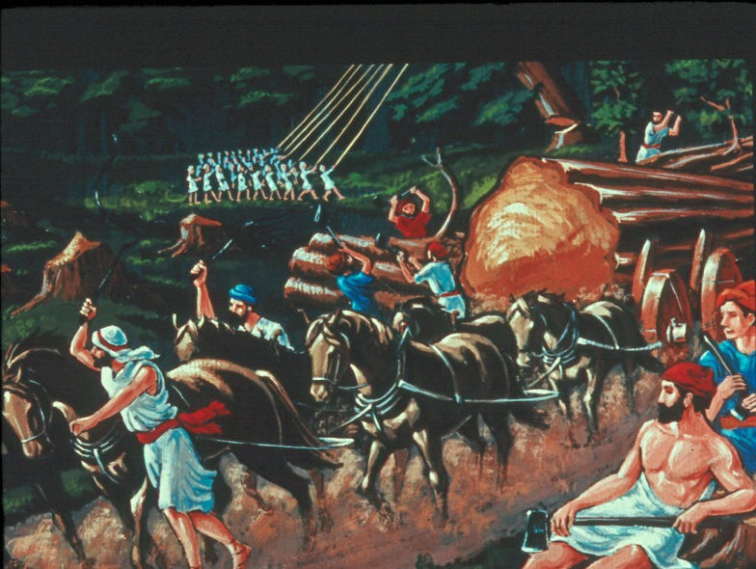

Slide 9
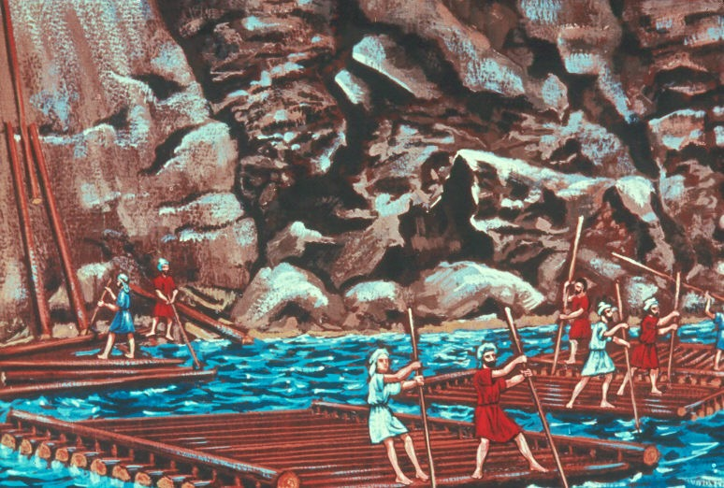

Slide 10
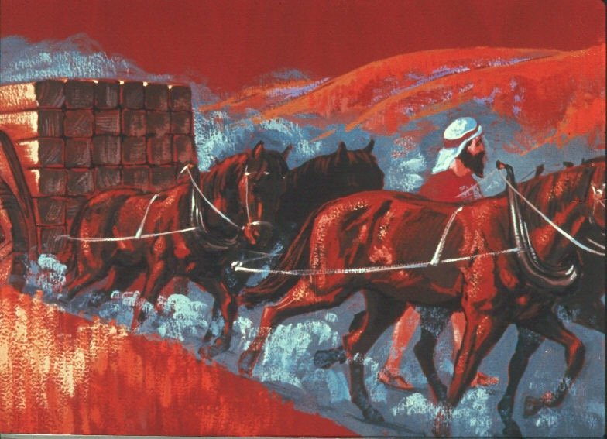

Slide 11


Slide 12
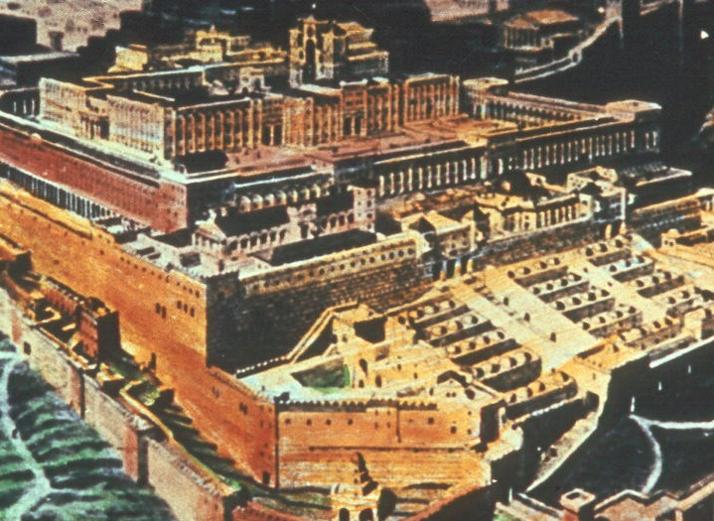

Slide 13
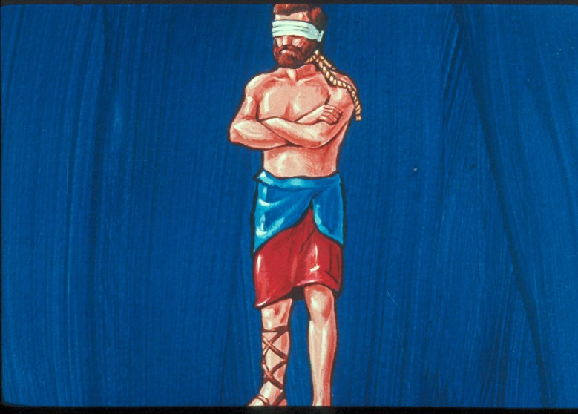

Slide 14
INTERNAL
NOT
EXTERNAL

Slide 15


Slide 16
RUTH 4:7
… to confirm all things;
a man plucked off his shoe,
and gave it to his neighbor…

Slide 17


Slide 18


Slide 19


Slide 20
MATTHEW 7:7
Ask, and it shall be given you;
seek, and ye shall find; knock,
and it shall be opened unto you.

Slide 21


Slide 22
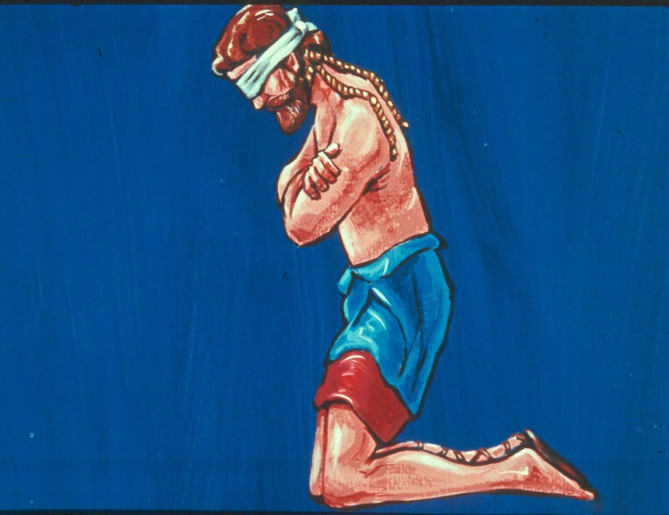

Slide 23
No man should ever engage in any great or important undertaking without first invoking the blessing of Deity.

Slide 24


Slide 25


Slide 26
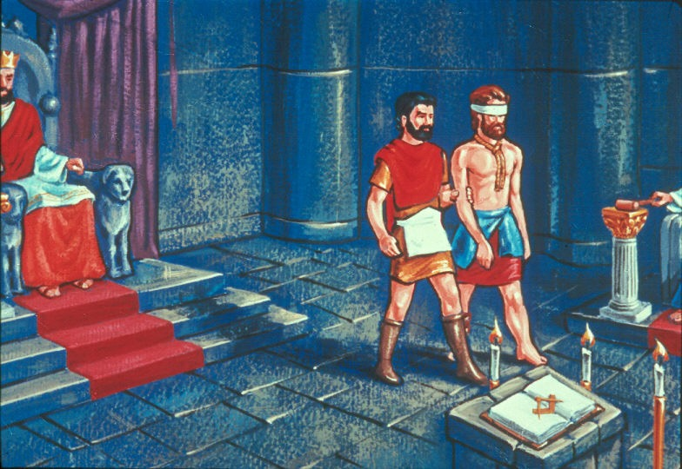

Slide 27
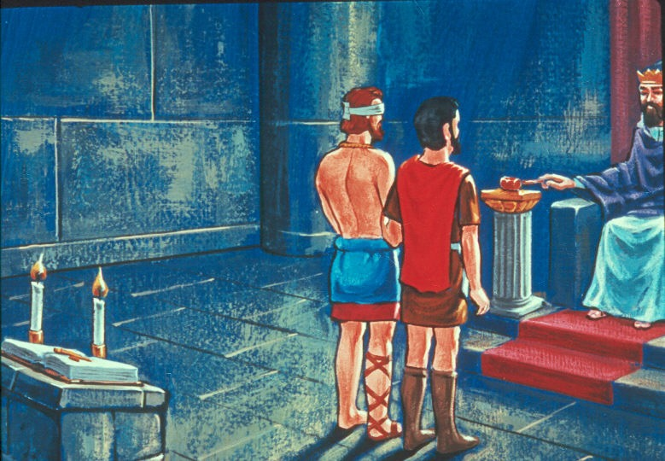

Slide 28


Slide 29


Slide 30


Slide 31
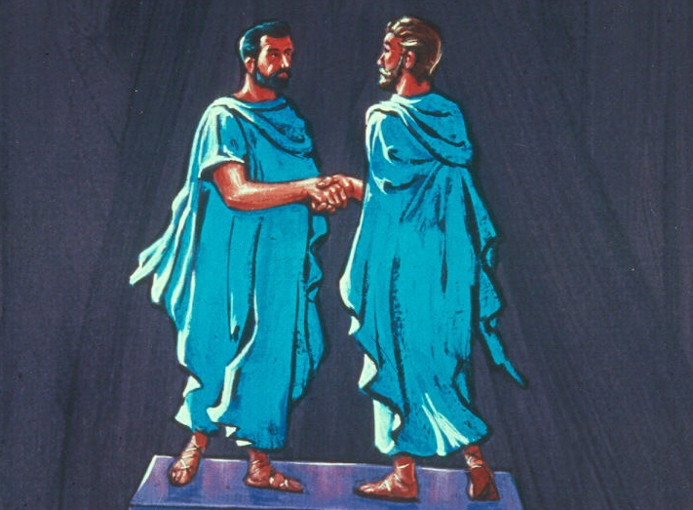

Slide 32


Slide 33


Slide 34
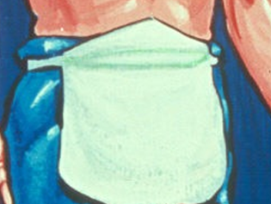

Slide 35
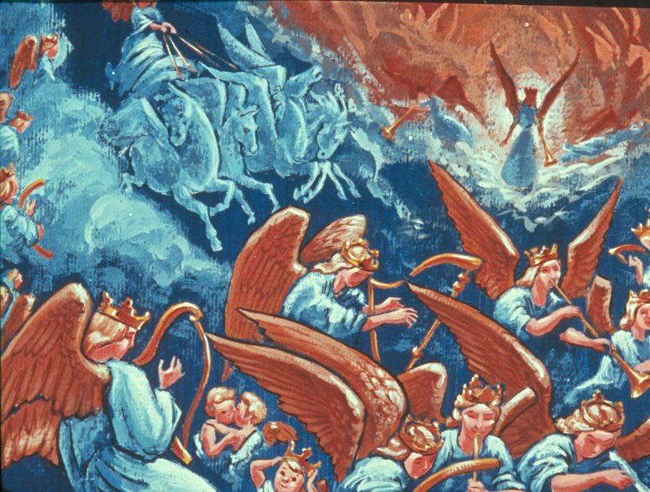

Slide 36
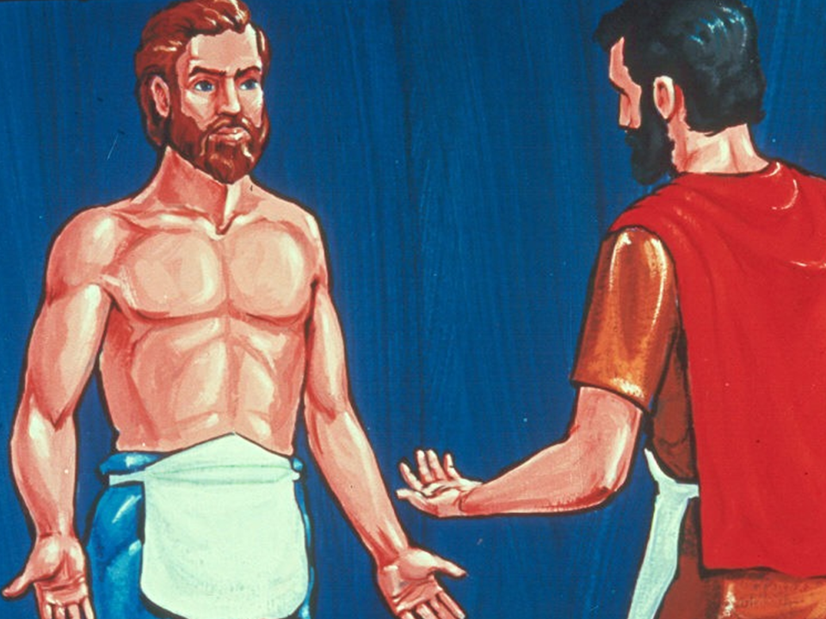

Slide 37
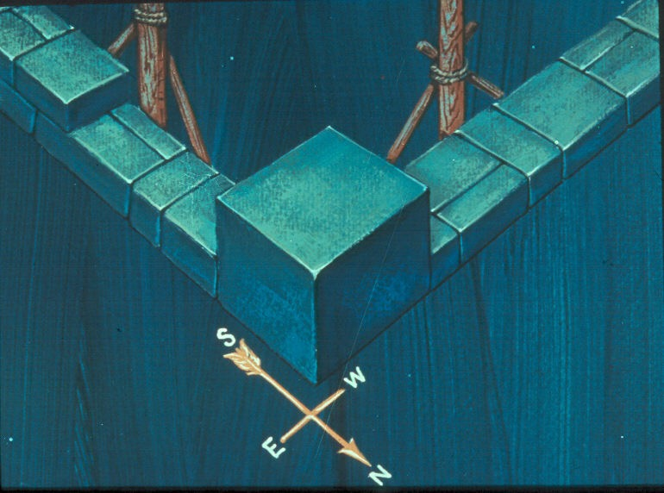

Slide 38
ENTERED APPRENTICE DEGREE
THIRD SECTION

Slide 39
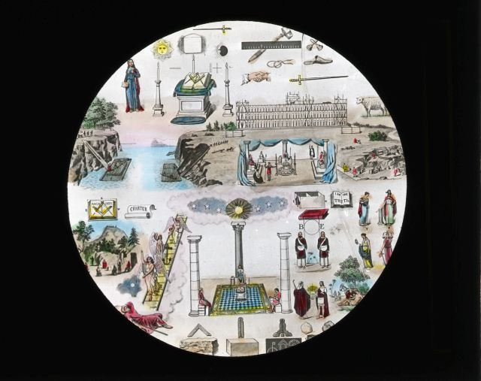

Slide 40


Slide 41
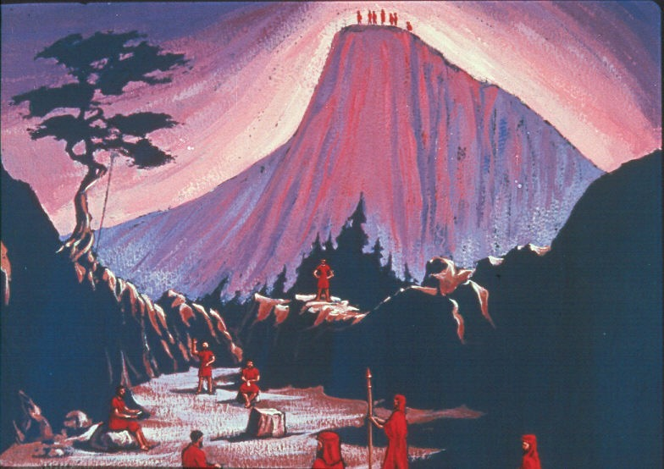

Slide 42
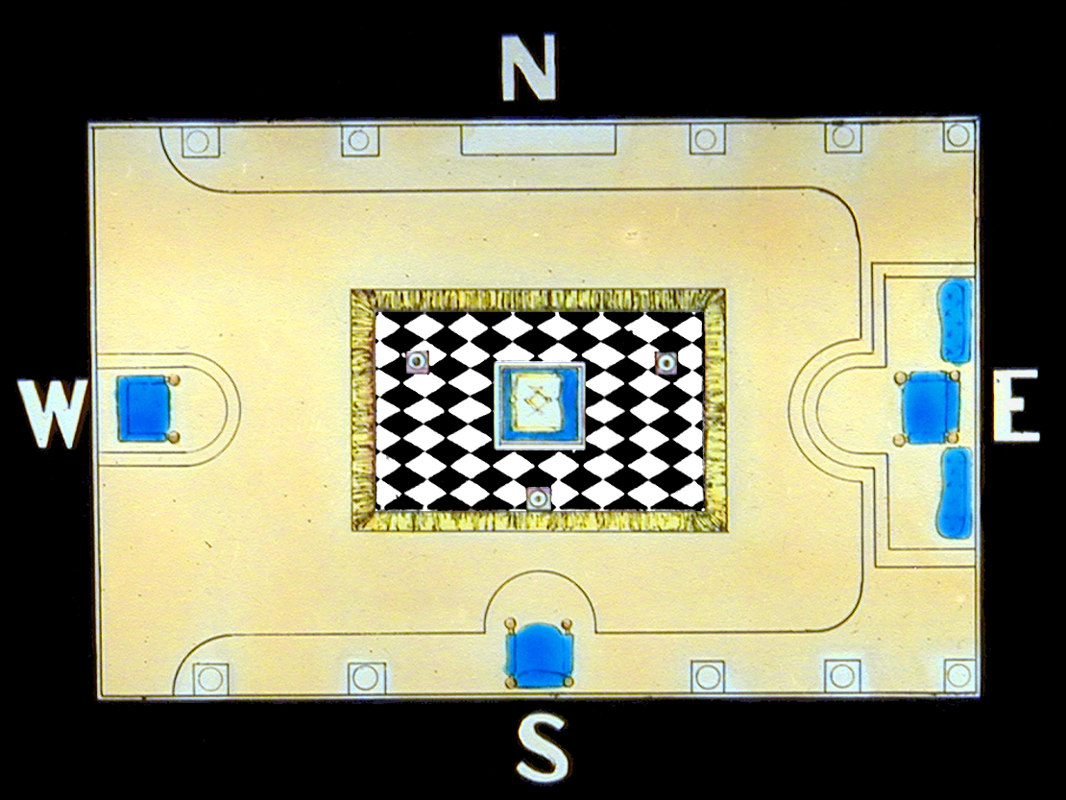

Slide 43


Slide 44


Slide 45


Slide 46
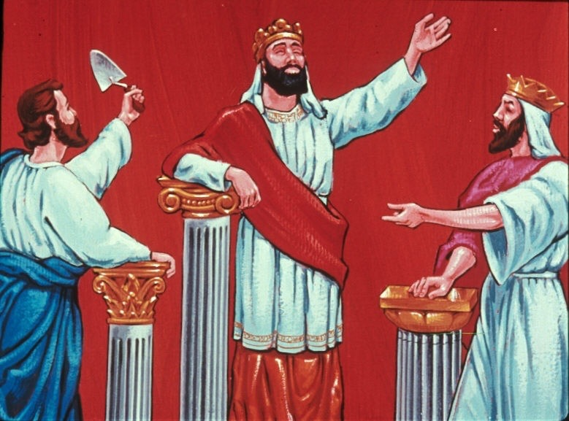
WISDOM
STRENGTH
BEAUTY

Slide 47

Worshipful Master

Slide 48

Senior Warden

Slide 49

Junior Warden

Slide 50


Slide 51
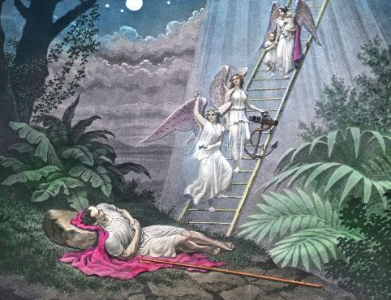

Slide 52
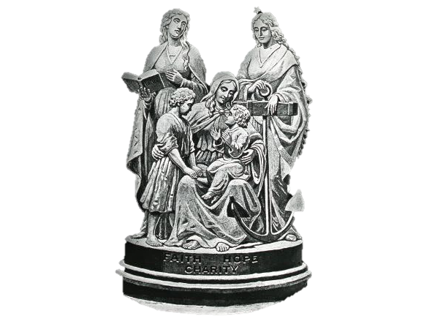

Slide 53
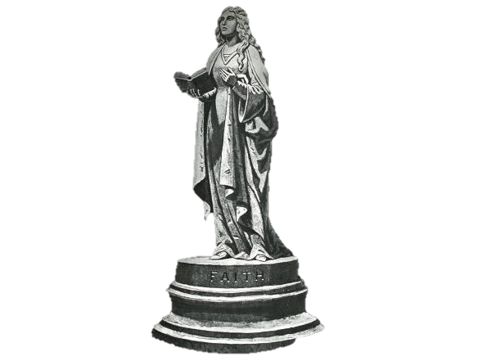

Slide 54
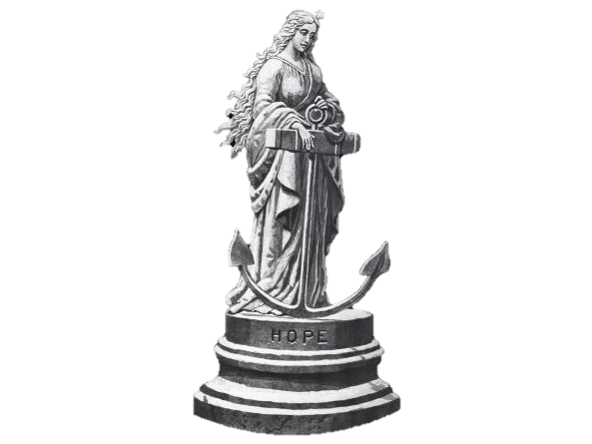

Slide 55
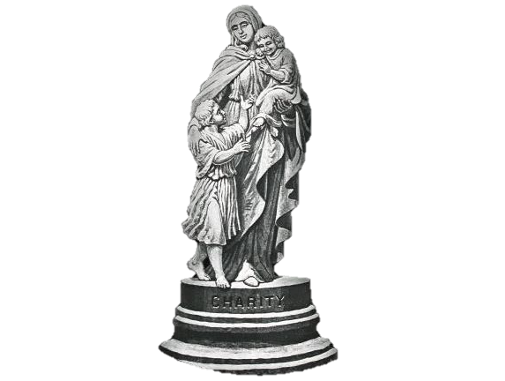

Slide 56


Slide 57
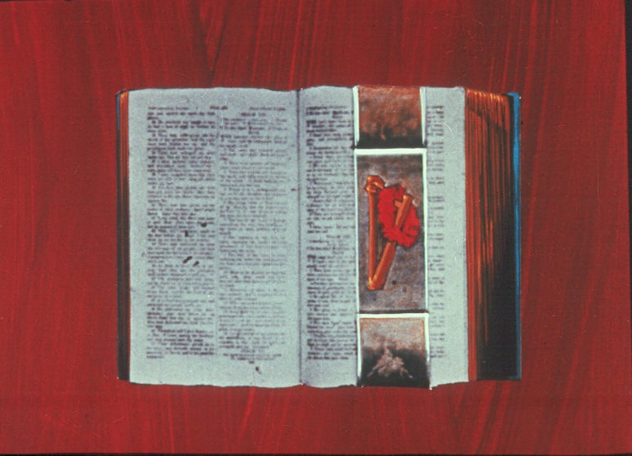

Slide 58


Slide 59
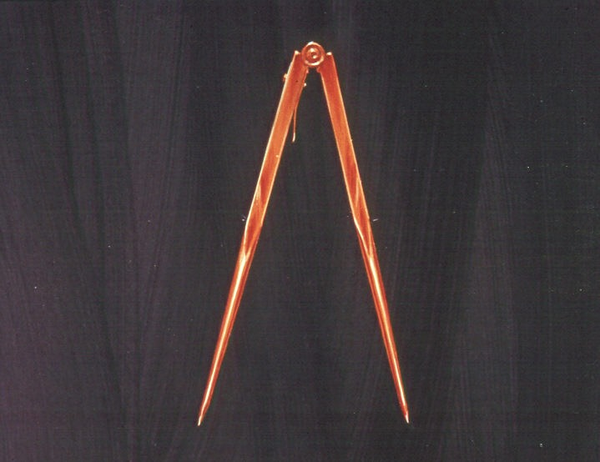

Slide 60


Slide 61


Slide 62
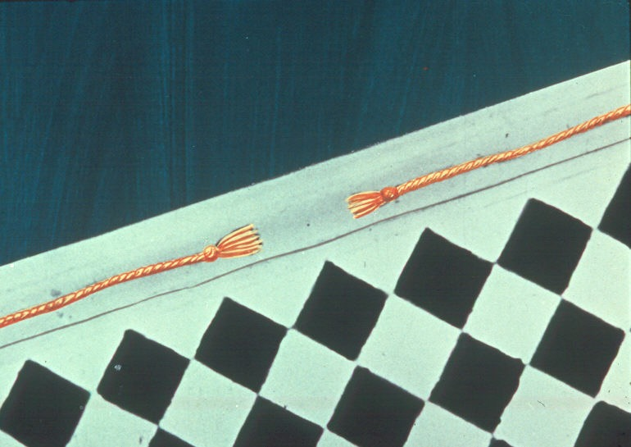

Slide 63


Slide 64
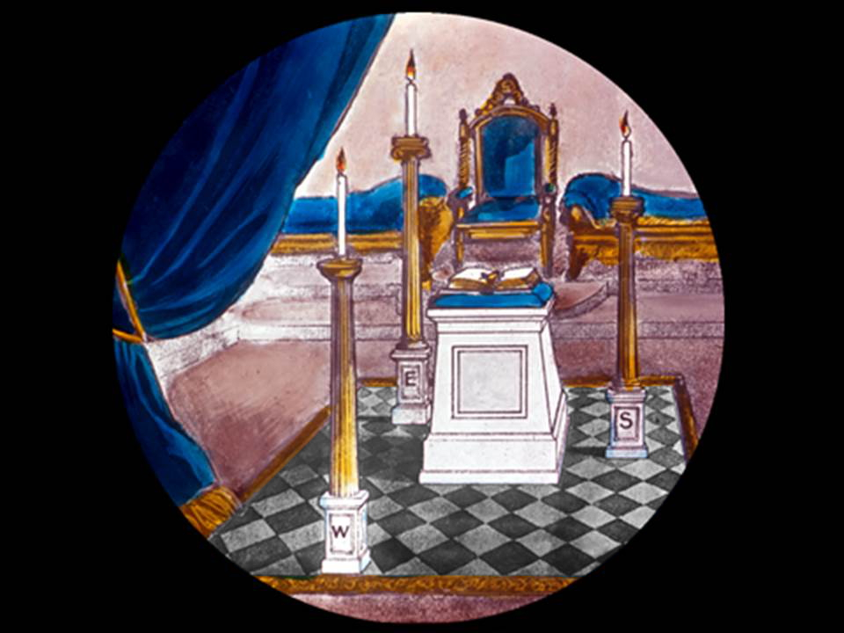

Slide 65
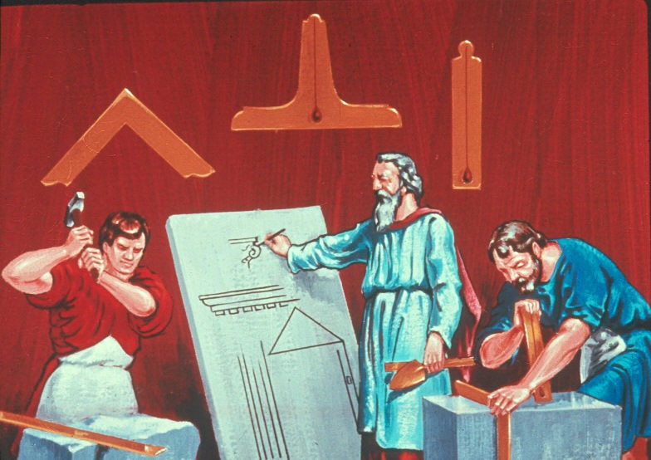

Slide 66
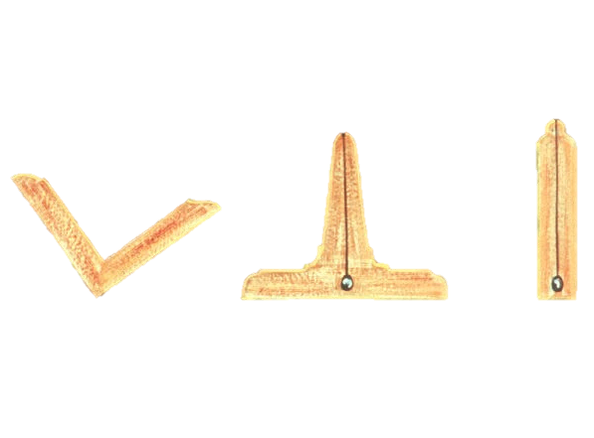

Slide 67
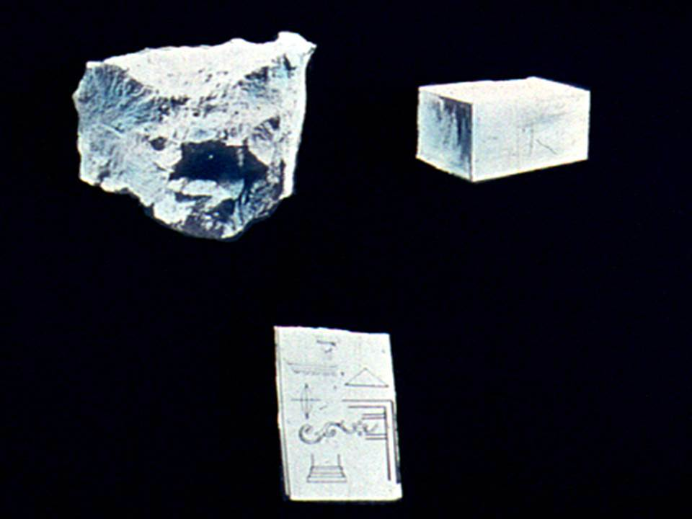

Slide 68


Slide 69


Slide 70


Slide 71
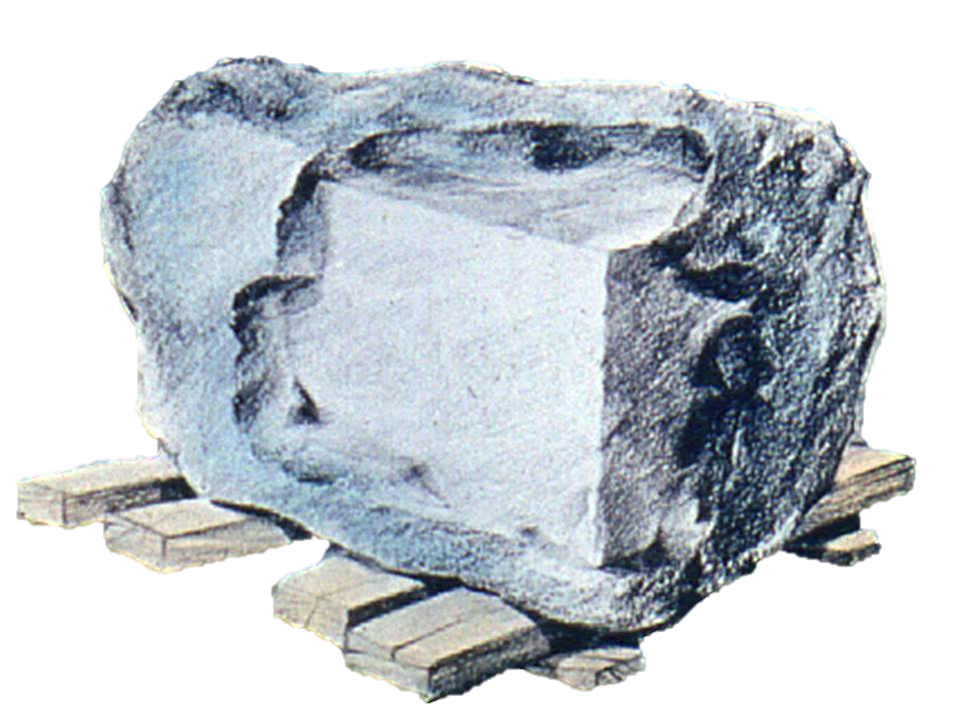

Slide 72
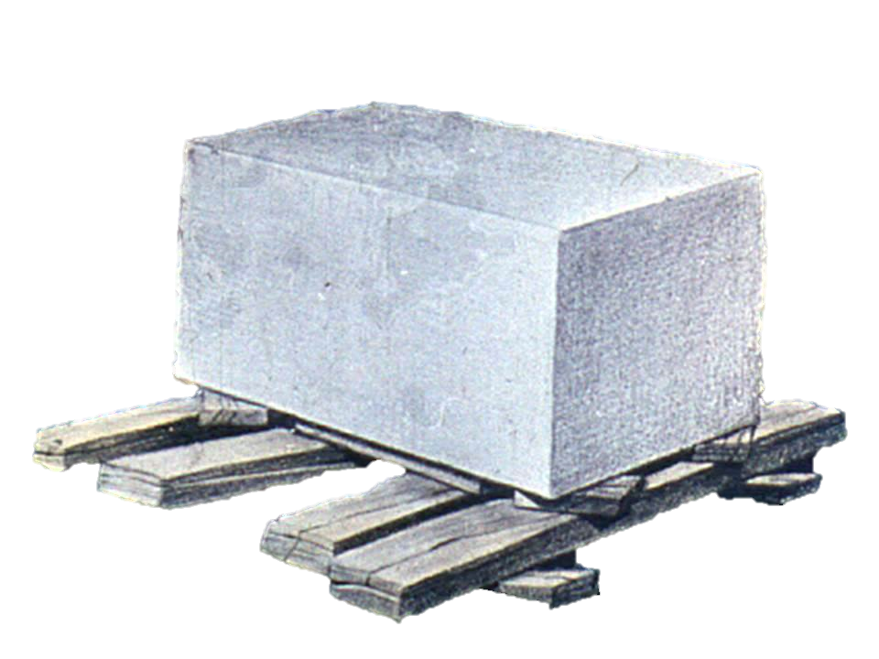

Slide 74
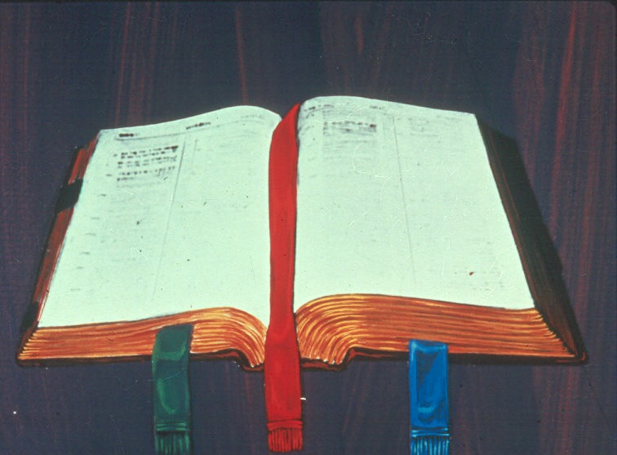

Slide 75


Slide 76
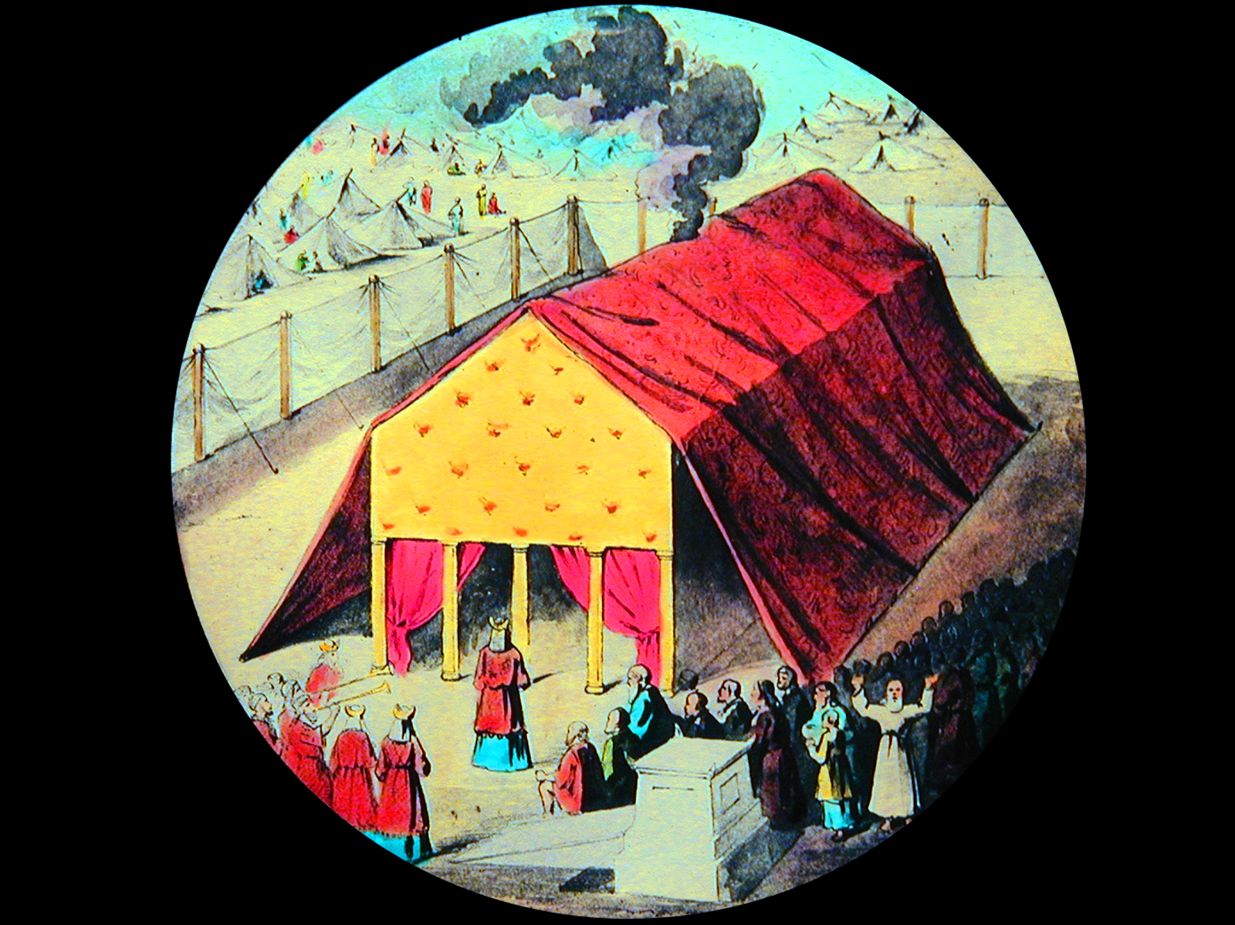

Slide 77
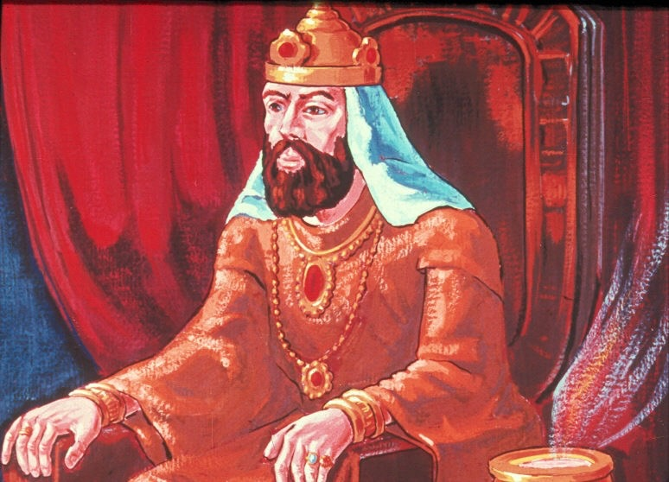

Slide 78
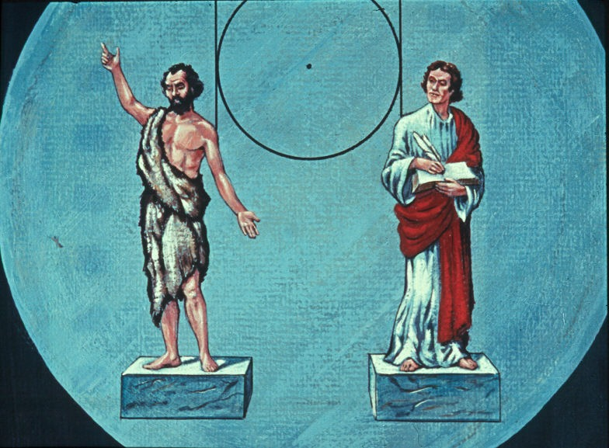

Slide 79
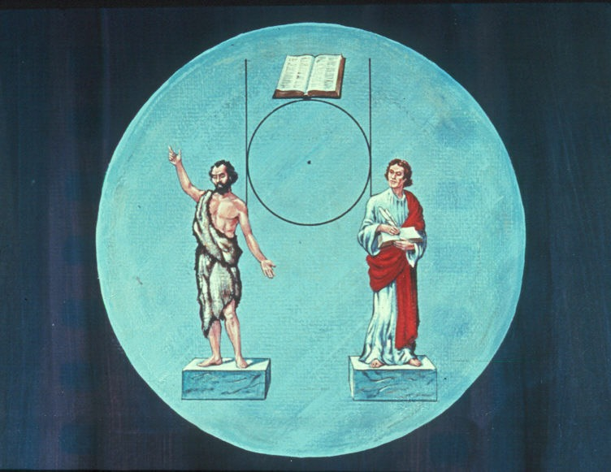

Slide 80


Slide 81


Slide 82


Slide 83
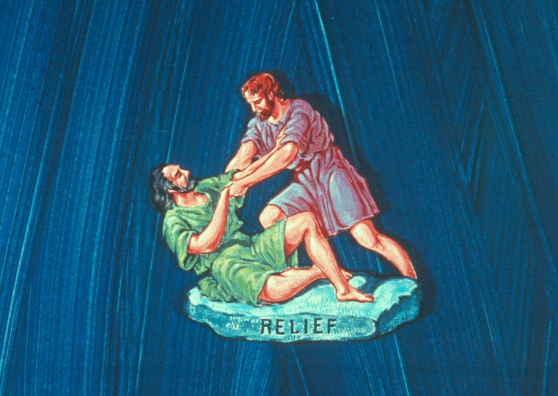

Slide 84
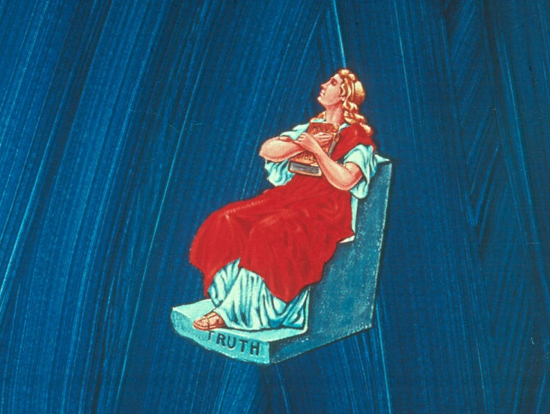

Slide 85
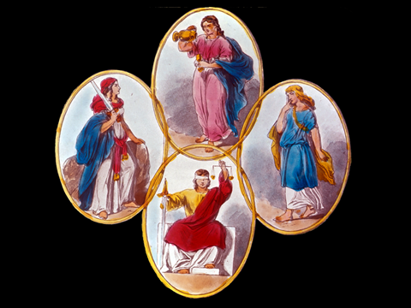

Slide 86
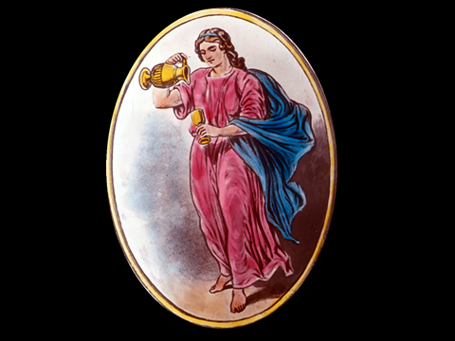
TEMPERANCE

Slide 88
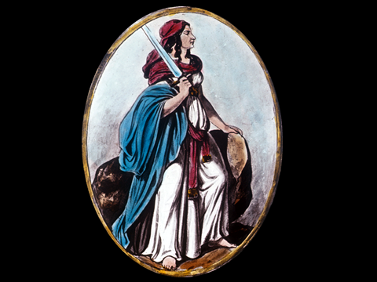
FORTITUDE

Slide 89


Slide 90
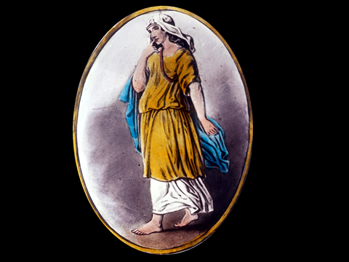
PRUDENCE

Slide 92
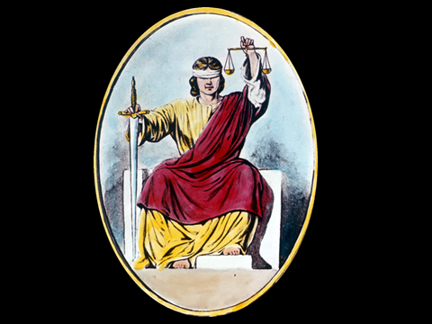
JUSTICE

Slide 94


Slide 95


Slide 96


Slide 97


Slide 98


Slide 99


Slide 100
ENTERED APPRENTICE DEGREE
CHARGE

Slide 101
Name of Lodge No. ---
ENTERED APPRENTICE DEGREE

